Slide 1
Quera Data Analysis Bootcamp:
WEB SCRAPING WITH PYTHON
A presentation by Parsa Abbasi
January, 2023

Slide 2
TABLE OF CONTENTS
01
05
02
06
03
04
Introduction
Forms and Logins
The Web
Selenium
BeautifulSoup
07
Techniques
Scrapy
08
Ethics

Slide 3
01
Introduction

Slide 4

What is Web Scraping?
"Web scraping, web harvesting, or web data extraction is data scraping used for extracting data from websites.“ (Thapelo, et al., 2016)
“The construction of an agent to download, parse, and organize data from the web in an automated manner.” (Broucke & Baesens, 2018)
Made by DALL-E

Slide 5

Why Web Scraping for Data Science?
Gathering data for a research project
Monitoring industry trends
Analyzing consumer sentiment
Creating a dataset for machine learning
Made by DALL-E
Notes:
Gathering data for a research project: If you are conducting research on a specific topic, web scraping can help you gather data from various sources such as news articles, blogs, and social media posts.
Monitoring industry trends: If you work in a specific industry, web scraping can help you keep track of trends and changes in your field by allowing you to gather data from industry-specific websites and news sources.
Analyzing consumer sentiment: If you are interested in understanding how people feel about a particular product or topic, web scraping can help you gather data from consumer reviews and social media posts.
Creating a dataset for machine learning: If you are working on a machine learning project and need a large dataset, web scraping can help you gather data from various sources and compile it into a single dataset.

Slide 6
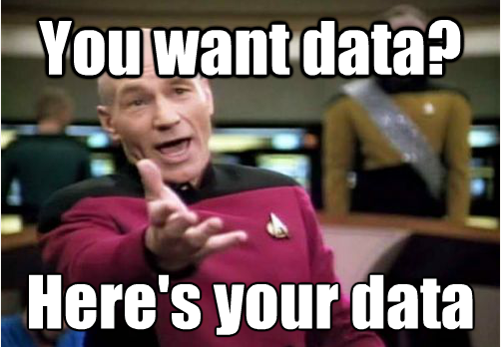
Why Web Scraping for Data Science?
Social network analytics
Retrieve information from Wikipedia
Enrich the dataset
Keeping track of competitors
Notes:
You might be wondering about doing social network analytics using profile data found on a web forum
There might be an interesting table on a Wikipedia page (or pages) you want to retrieve to perform some statistical analysis
You’d like to gather additional features to enrich your data set based on information found on the web, say, weather information to forecast, for example, soft drink sales
Keeping track of competitors: If you run a business, web scraping can help you keep track of what your competitors are doing by allowing you to gather data from their websites and social media accounts.

Slide 7
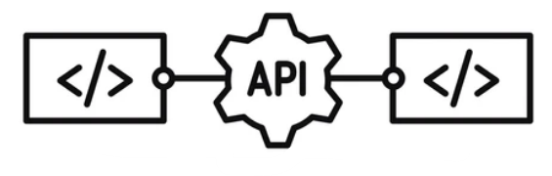
What about APIs?
The general rule of thumb:
Look for an API first and use that if you can.
Some reasons why web scraping might be preferable over the use of an API:
The website does not provide an API.
The API provided is not free, or is too expensive.
API access rate is limited.
The API does not expose all the data you wish to obtain.
API documentation is poor.

Slide 8

What is Web Crawling?
Web crawling is the process of automatically visiting web pages and following links to other pages within the same website or to other websites.
“In general terms, the term crawler indicates a program’s ability to navigate web pages on its own, perhaps even without a well-defined end goal or purpose, endlessly exploring what a site or the web has to offer..” (Broucke & Baesens, 2018)
Made by DALL-E
Notes:
The difference between “web scraping” and “web crawling” is relatively vague, as many authors and programmers will use both terms interchangeably. In general terms, the term “crawler” indicates a program’s ability to navigate web pages on its own, perhaps even without a well-defined end goal or purpose, endlessly exploring what a site or the web has to offer. Web crawlers are heavily used by search engines like Google to retrieve contents for a URL, examine that page for other links, retrieve the URLs for those links, and so on…
Outputs:
Web Crawling: List of visited websites, links between websites.
Web Scraping: Structured data such as a spreadsheet or a database.

Slide 9
02
The Web

Slide 10
Connecting
“Once you start web scraping, you start to appreciate all the little things that browsers do for you.” (Mitchell, 2018)
To give you an idea of the infrastructure required to get information to your browser, let’s use the following example: (Mitchell, 2018)
Alice owns a web server.
Bob uses a desktop computer, which is trying to connect to Alice’s server.
When one machine wants to talk to another machine, something like the following exchange takes place:

Slide 11
Connecting: Example
01
Bob’s computer sends along a stream of 1 and 0 bits, indicated by high and low voltages on a wire.
These bits form some information, containing a header and body.
The header contains an immediate destination of his local router’s MAC address, with a final destination of Alice’s IP address.
The body contains his request for Alice’s server application.

Slide 12
Connecting: Example
02
Bob’s local router receives all these 1s and 0s and interprets them as a packet, from Bob’s own MAC address, destined for Alice’s IP address.
His router stamps its own IP address on the packet as the “from” IP address, and sends it off across the internet.

Slide 13
Connecting: Example
03
Bob’s packet traverses several intermediary servers, which direct his packet toward the correct physical/wired path, on to Alice’s server.

Slide 14
Connecting: Example
04
Alice’s server receives the packet at her IP address.

Slide 15
Connecting: Example
05
Alice’s server reads the packet port destination in the header, and passes it off to the appropriate application—the web server application.
(The packet port destination is almost always port 80 for web applications; this can be thought of as an apartment number for packet data, whereas the IP address is like the street address.)

Slide 16
Connecting: Example
06
The web server application receives a stream of data from the server processor.
This data says something like the following:
This is a GET request.
The following file is requested: index.html.

Slide 17
Connecting: Example
07
The web server locates the correct HTML file
Bundles it up into a new packet to send to Bob
And sends it through to its local router, for transport back to Bob’s machine, through the same process.

Slide 18
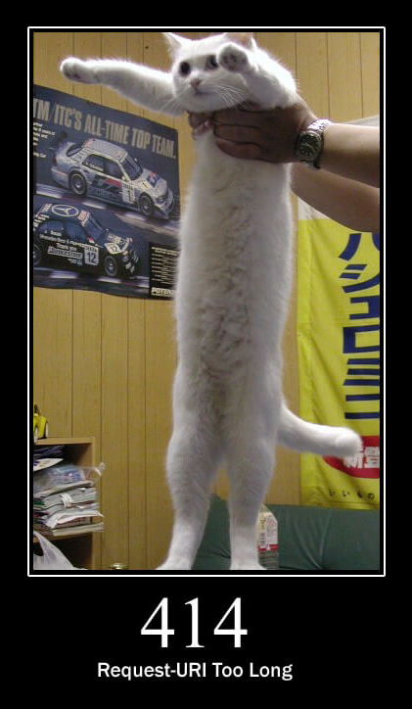
HTTP
As we recall, a client (the web browser, in most cases) and web server will communicate by sending plain text messages. The client sends requests to the server and the server sends responses, or replies.
The core component in the exchange of messages consists of a HyperText Transfer Protocol (HTTP) request message to a web server, followed by an HTTP response (also oftentimes called an HTTP reply). (Broucke & Baesens, 2018)

Slide 19
HTTP: Example
GET / HTTP/1.1
Host: example.com
Connection: keep-alive
Cache-Control: max-age=0
Upgrade-Insecure-Requests: 1
User-Agent: Mozilla/5.0 (Windows NT 10.0; Win64; x64) AppleWebKit/537.36 
(KHTML, like Gecko) Chrome/60.0.3112.90 Safari/537.36
Accept: text/html,application/xhtml+xml,application/xml;q=0.9,*/*;q=0.8
Referer: https://www.google.com/
Accept-Encoding: gzip, deflate
Accept-Language: en-US,en;q=0.8,nl;q=0.6
<CR><LF>
Notes:
Let’s take a closer look at this message. “GET / HTTP/1.1” is the request line. It contains the HTTP “verb” or “method” we want to execute (“GET” in the example above), the URL we want to retrieve (“/”), and the HTTP version we understand (“HTTP/1.1”). “GET” means this: “get the contents of this URL for me.” Every time you enter a URL in your address bar and press enter, your browser will perform a GET request.
Next up are the request headers, each on their own line. In this example, we already have quite a few of them. Note that each header includes a name (“Host,” for instance), followed by a colon (“:”) and the actual value of the header (“example.com”). Browsers are very chatty in terms of what they like to include in their headers, and Chrome (the web browser used here, is no exception).
Apart from the mandatory “Host” header, we also see a number of other headers
appearing that form a set of “standardized requests headers,” which are not mandatory,
though nevertheless included by all modern web browsers. “Connection: keep-alive, for instance, signposts to the server that it should keep the connection open for subsequent requests if it can. The “User-Agent” contains a large text value through which the browser happily informs the server what it is (Chrome), and which version it is running as.
“Accept” tells the server which forms of content the browser prefers to get back, and
“Accept-Encoding” tells the server that the browser is also able to get back compressed
content. The “Referer” header (a deliberate misspelling) tells the server from which page
the browser comes from (in this case, a link was clicked on “google.com” sending the
browser to “example.com”).

Slide 20
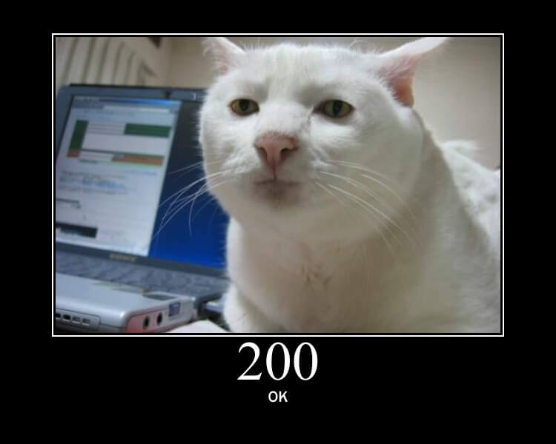
HTTP: Example
HTTP/1.1 200 OK
Connection: keep-alive
Content-Encoding: gzip
Content-Type: text/html;charset=utf-8
Date: Mon, 28 Aug 2017 10:57:42 GMT
Server: Apache v1.3
Vary: Accept-Encoding
Transfer-Encoding: chunked
<CR><LF>
<html>
<body>Welcome to My Web Page</body>
</html>
Notes:
Let’s take a closer look at this message. “GET / HTTP/1.1” is the request line. It contains the HTTP “verb” or “method” we want to execute (“GET” in the example above), the URL we want to retrieve (“/”), and the HTTP version we understand (“HTTP/1.1”). “GET” means this: “get the contents of this URL for me.” Every time you enter a URL in your address bar and press enter, your browser will perform a GET request.
Next up are the request headers, each on their own line. In this example, we already have quite a few of them. Note that each header includes a name (“Host,” for instance), followed by a colon (“:”) and the actual value of the header (“example.com”). Browsers are very chatty in terms of what they like to include in their headers, and Chrome (the web browser used here, is no exception).
Apart from the mandatory “Host” header, we also see a number of other headers
appearing that form a set of “standardized requests headers,” which are not mandatory,
though nevertheless included by all modern web browsers. “Connection: keep-alive, for instance, signposts to the server that it should keep the connection open for subsequent requests if it can. The “User-Agent” contains a large text value through which the browser happily informs the server what it is (Chrome), and which version it is running as.
“Accept” tells the server which forms of content the browser prefers to get back, and
“Accept-Encoding” tells the server that the browser is also able to get back compressed
content. The “Referer” header (a deliberate misspelling) tells the server from which page
the browser comes from (in this case, a link was clicked on “google.com” sending the
browser to “example.com”).

Slide 21
The requests library
The Python requests library is a powerful and easy-to-use library for making HTTP requests in Python. With requests, you can send HTTP requests using various methods, such as GET, POST, PUT, DELETE, and more. It also supports various authentication methods, cookies, and other advanced features.
pip install requests
import requests
response = requests.get('https://quera.org')
print(response.status_code) # prints the status code
print(response.headers) # prints the response headers
print(response.text) # prints the response body

Slide 22
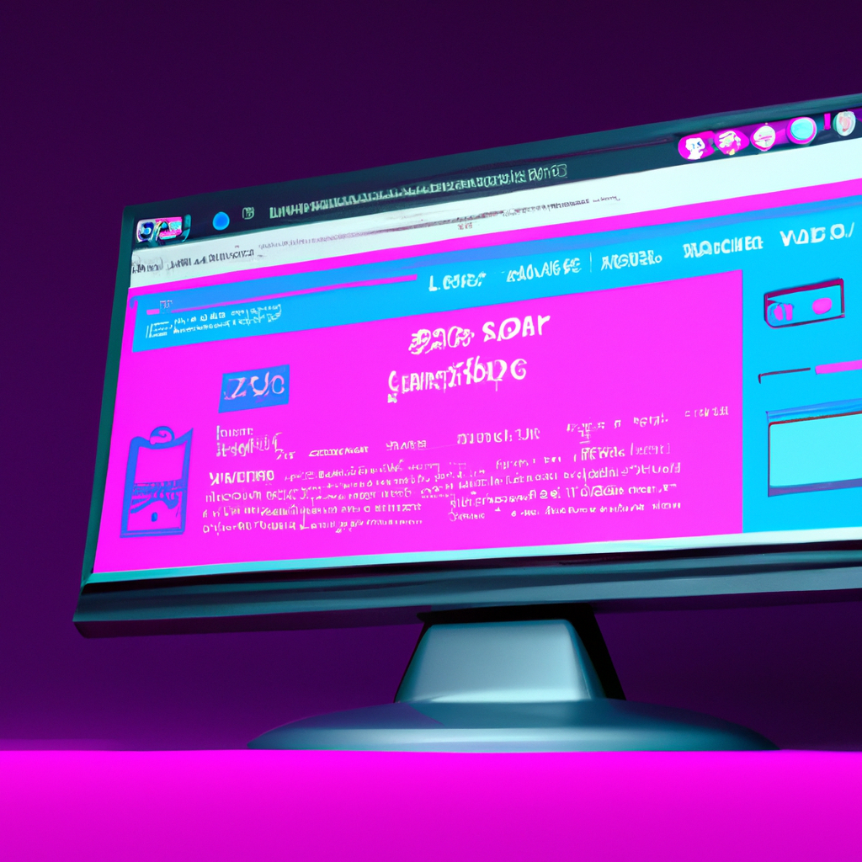
HyperText Markup Language (HTML)
It is the standard markup language for creating web pages
HTML consists of a series of elements that are used to structure and format content on the web
HTML is often used to structure and format the content that is included in an HTTP response.
Made by DALL-E

Slide 23
HyperText Markup Language (HTML)
An HTML document consists of a series of elements, each contained within an opening and closing tag.
<!DOCTYPE html>
<html>
<head>
<title>My Page</title>
</head>
<body>
<h1>Welcome to my page</h1>
<p>This is some text</p>
</body>
</html>

Slide 24
HyperText Markup Language (HTML)
Elements are the building blocks of an HTML page.
Some common elements include:
<h1> to <h6>: headings
<p>: paragraph
<a>: hyperlink
<div>: division or container
<img>: image
Elements can also have attributes, which provide additional information about the element.
<img src="image.jpg" alt="A description of the image">

Slide 25

Cascading Style Sheets (CSS)
It is a style sheet language used for describing the look and formatting of a document written in HTML
CSS is used to control the layout, font, color, and other visual aspects of an HTML document
Made by DALL-E

Slide 26
Cascading Style Sheets (CSS)
CSS works by selecting elements in an HTML document and applying styles to them.
h1 {
color: red;
font-size: 24px;
}
p {
color: blue;
font-size: 18px;
}

Slide 27
Cascading Style Sheets (CSS)
There are several ways to select elements in an HTML document using CSS. Some common selectors include:
element: selects all elements with the given element name
.class: selects all elements with the given class name
#id: selects the element with the given id
element element: selects all elements that are descendants of the given element
element > element: selects all elements that are children of the given element

Slide 28
Cascading Style Sheets (CSS)
There are three ways to apply CSS to an HTML document:
<!-- Inline -->
<h1 style="color: red; font-size: 24px;">Heading</h1>
<!-- Internal -->
<style>
h1 {
color: red;
font-size: 24px;
}
</style>
<!-- External -->
<link rel="stylesheet" href="style.css">

Slide 29
Inspect
The Inspect Element feature in web browsers allows you to view and modify the HTML and CSS of a web page in real-time. This can be useful for debugging, testing, and learning how a web page is constructed.
Open the web page you want to inspect.
Right-click on the page and select "Inspect" or "Inspect Element" from the context menu. Alternatively, you can use the keyboard shortcut:
Windows: F12 or Ctrl + Shift + I
Mac: Cmd + Opt + I
The Inspector panel will open. It consists of two main sections: the Elements tab and the Styles tab.

Slide 30


Slide 31
03
BeautifulSoup

Slide 32
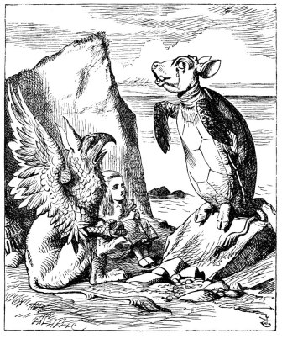
Introduction
The BeautifulSoup library was named after a Lewis Carroll poem of the same name in Alice’s Adventures in Wonderland.
Like its Wonderland namesake, BeautifulSoup tries to make sense of the nonsensical; it helps format and organize the messy web by fixing bad HTML and presenting us with easily traversable Python objects representing XML structures. (Mitchell, 2018)
Beautiful Soup, so rich and green,
Waiting in a hot tureen!
Who for such dainties would not stoop?
Soup of the evening, beautiful Soup!

Slide 33
Installation
BeautifulSoup4 requires Python 3.6+
You can install BeautifulSoup4 and its dependencies from PyPI with:
More information: https://www.crummy.com/software/BeautifulSoup/
pip install beautifulsoup4

Slide 34
Let’s talk with code!
File name: beautiful_soup.ipynb

Slide 35

Handling Exceptions
One of the most frustrating experiences in web scraping is to go to sleep with a scraper running, dreaming of all the data you’ll have in your database the next day—only to find that the scraper hit an error on some unexpected data format and
stopped execution shortly after you stopped looking at the screen. (Mitchell, 2018)
Made by DALL-E

Slide 36
Handling Exceptions: requests
HTTPError
HTTP error indicate that something went wrong on the server while processing the request.
try:
response = requests.get(url, timeout=5)
response.raise_for_status()
except HTTPError as http_err:
print('HTTP error occurred: {}'.format(http_err))

Slide 37
Handling Exceptions: requests
ConnectionError
Raised when a connection to the server could not be established.
try:
response = requests.get(url, timeout=5)
response.raise_for_status()
except HTTPError as http_err:
print('HTTP error occurred: {}'.format(http_err))
except ConnectionError as conn_err:
print('Connection error occurred: {}'.format(conn_err))

Slide 38
Handling Exceptions: requests
Timeout
The connection or server times out.
try:
response = requests.get(url, timeout=5)
response.raise_for_status()
except HTTPError as http_err:
print('HTTP error occurred: {}'.format(http_err))
except ConnectionError as conn_err:
print('Connection error occurred: {}'.format(conn_err))
except Timeout as timeout_err:
print('Timeout error occurred: {}'.format(timeout_err))

Slide 39
Handling Exceptions: requests
RequestException
There was an ambiguous exception that occurred while handling your request.
try:
response = requests.get(url, timeout=5)
response.raise_for_status()
except HTTPError as http_err:
print('HTTP error occurred: {}'.format(http_err))
except ConnectionError as conn_err:
print('Connection error occurred: {}'.format(conn_err))
except Timeout as timeout_err:
print('Timeout error occurred: {}'.format(timeout_err))
except RequestException as req_err:
print('Request error occurred: {}'.format(req_err))

Slide 40
Handling Exceptions: BeautifulSoup
Every time you access a tag in a BeautifulSoup object, it’s smart to add a check to make sure the tag actually exists.
If you attempt to access a tag that does not exist, BeautifulSoup will return a None object.
try:
badContent = bs.nonExistingTag.anotherTag
except AttributeError as e:
print('Tag was not found!')
else:
if badContent == None:
print('Tag was not found!')
else:
print(badContent)
The problem is, attempting to access a tag on a None object itself will result in an AttributeError being thrown. (Mitchell, 2018)

Slide 41
Regular Expressions (regex)
BeautifulSoup and regular expressions go hand in hand when it comes to scraping the web. In fact, most functions that take in a string argument (e.g., find(id="aTagIdHere")) will also take in a regular expression just as well. (Mitchell, 2018)
import re
url = 'http://www.pythonscraping.com/pages/page3.html'
html = requests(url)
bs = BeautifulSoup(html, 'html.parser')
images = bs.find_all('img’,
{'src':re.compile('\.\.\/img\/gifts/img.*\.jpg')})
for image in images:
print(image['src'])
../img/gifts/img1.jpg
../img/gifts/img2.jpg
../img/gifts/img3.jpg
../img/gifts/img4.jpg
../img/gifts/img6.jpg

Slide 42
Lambda Expressions
BeautifulSoup allows you to pass certain types of functions as parameters into the find_all function.
The only restriction is that these functions must take a tag object as an argument and return a boolean.
Every tag object that BeautifulSoup encounters is evaluated in this function, and tags that evaluate to True are returned, while the rest are discarded
bs.find_all(lambda tag: len(tag.attrs) == 2)
<div class="body" id="content"></div>
<span style="color:red" class="title"></span>

Slide 43

A PRACTICAL EXAMPLE
Scraping jobs from Quera Magnet
Folder name: quera_magnet

Slide 44
04
Scrapy

Slide 45
Introduction
Scrapy is an open-source web crawling framework written in Python. It is used to extract data from websites and store it in the desired format.
Feature | Scrapy | BeautifulSoup
Speed | Fast (able to crawl multiple pages concurrently) | Slow (single threaded)
Handling and following links | Built-in mechanism for handling and following links | No built-in mechanism for handling and following links
Extensibility | Highly extensible (middlewares and extensions) | Limited extensibility
Data cleaning and manipulation | Built-in support for data cleaning and manipulation | Limited support for data cleaning and manipulation
Community and documentation | Large and active community, with extensive documentation | Active community, with good documentation

Slide 46
Installation
Scrapy requires Python 3.7+
To install Scrapy using conda, run:
You can install Scrapy and its dependencies from PyPI with:
More information: https://docs.scrapy.org/en/latest/intro/install.html
conda install -c conda-forge scrapy
pip install Scrapy

Slide 47
Initialization
Once Scrapy is installed, you can create a new Scrapy project by running the following command:
scrapy startproject myproject
myproject/
scrapy.cfg
myproject/
__init__.py
items.py
middlewares.py
pipelines.py
settings.py
spiders/
__init__.py
This will create a new directory called myproject with the following structure:
The items.py file is where you will define the items that you want to scrape.

Slide 48
XPATH
XPATH is particularly useful for selecting elements with complex, nested structures, because it allows you to select elements based on their position in the document hierarchy.
<html>
<body>
<div class="container">
<div class="row">
<div class="col-md-6">
<h2>Title</h2>
<p>Description</p>
<a href="http://www.example.com">Link</a>
</div>
</div>
</div>
</body>
</html>
Selecting the h2 element that is a child of the div element with the class col-md-6.
//div[@class="col-md-6"]/h2
Selecting all the a elements that have the attribute target with the value "_blank".
//a[@target="_blank"]
Selecting the third div element
//div[3]

Slide 49

robot.txt
A robots.txt file is used primarily to manage crawler traffic to a site, and usually to keep a file off search engines like Google, depending on the file type.
To bypass the robot.txt file in Scrapy, you can use the ROBOTSTXT_OBEY setting and set it to False.
# Obey robots.txt rules
ROBOTSTXT_OBEY = False
Made by DALL-E

Slide 50
Pipeline
After an item has been scraped by a spider, it is sent to the Item Pipeline which processes it through several components that are executed sequentially.
Each item pipeline component (sometimes referred as just “Item Pipeline”) is a Python class that implements a simple method. They receive an item and perform an action over it, also deciding if the item should continue through the pipeline or be dropped and no longer processed.
Don’t forget to enable the pipeline in the Scrapy settings by adding it to the ITEM_PIPELINES setting.

Slide 51
A PRACTICAL EXAMPLE
Scraping books from Bidgol Publishing
Folder name: bidgol

Slide 52
05
Forms and Logins

Slide 53

Introduction
One of the first questions that comes up when you start to move beyond the basics of web scraping is: “How do I access information behind a login screen?”
The web isincreasingly moving toward interaction, social media, and user-generated content. Forms and logins are an integral part of these types of sites and almost impossible to avoid. Fortunately, they are also relatively easy to deal with.
Made by DALL-E

Slide 54
A Basic Form
<form method="post" action="processing.php">
First name: <input type="text" name="firstname"><br>
Last name: <input type="text" name="lastname"><br>
<input type="submit" value="Submit">
</form>
import requests
params = {'firstname': 'Ryan', 'lastname': 'Mitchell'}
r = requests.post("http://pythonscraping.com/pages/processing.php", data=params)
print(r.text)

Slide 55
Other Types of Inputs
Standard HTML contains a wide variety of possible form input fields: radio buttons, checkboxes, and select boxes, to name a few. HTML5 adds sliders (range input fields), email, dates, and more. With custom JavaScript fields, the possibilities are endless, with color pickers, calendars, and whatever else the developers come up with next.
You need to worry about only two things: the name of the element and its value.
The element’s name can be easily determined by looking at the source code and finding the name attribute.
The value can sometimes be trickier, as it might be populated by JavaScript immediately before form submission.

Slide 56
Other Types of Inputs
Look at the URL of a site. If the URL is something like:
http://domainname.com?thing1=foo&thing2=bar
You know that this corresponds to a form of this type:
<form method="GET" action="someProcessor.php">
<input type="someCrazyInputType" name="thing1" value="foo" />
<input type="anotherCrazyInputType" name="thing2" value="bar" />
<input type="submit" value="Submit" />
</form>

Slide 57
Other Types of Inputs
If you’re stuck with a complicated-looking POST form, and you want to see exactly
which parameters your browser is sending to the server, the easiest way is to use your browser’s inspector or developer tool to view them.

Slide 58
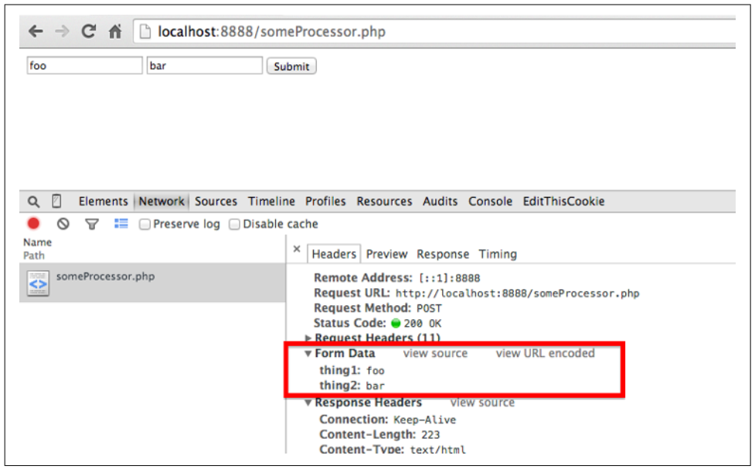

Slide 59
Login and Cookies
Most modern websites use cookies to keep track of who is logged in and who is not. After a site authenticates your login credentials, it stores them in your browser’s cookie, which usually contains a server-generated token, time-out, and tracking information.
Although cookies are a great solution for web developers, they can be problematic for web scrapers. You can submit a login form all day long, but if you don’t keep track of the cookie the form sends back to you afterward, the next page you visit will act as though you’ve never logged in at all.

Slide 60
Login and Cookies
import requests
params = {'username': 'Ryan', 'password': 'password'}
r = requests.post('http://pythonscraping.com/pages/cookies/welcome.php', params)
print('Cookie is set to:')
print(r.cookies.get_dict())
print('Going to profile page...')
r = requests.get('http://pythonscraping.com/pages/cookies/profile.php’,
cookies=r.cookies)
print(r.text)
Here you’re sending the login parameters to the welcome page, which acts as the processor for the login form. You retrieve the cookies from the results of the last request, print the result for verification, and then send them to the profile page by setting the cookies argument

Slide 61
Login and Cookies
What if you’re dealing with a more complicated site that frequently modifies cookies without warning, or if you’d rather not even think about the cookies to begin with? The Requests session function works perfectly in this case:
import requests
session = requests.Session()
params = {'username': 'username', 'password': 'password'}
s = session.post('http://pythonscraping.com/pages/cookies/welcome.php', params)
print('Cookie is set to:')
print(s.cookies.get_dict())
print('Going to profile page...')
s = session.get('http://pythonscraping.com/pages/cookies/profile.php')
print(s.text)

Slide 62
06
Selenium

Slide 63
Introduction
Selenium is a tool that can be used for web scraping, as it allows you to control a web browser and interact with web pages programmatically.
Feature | Selenium | Scrapy
Requires web browser | Yes | No
Supports JavaScript | Yes | No
Speed and efficiency | Lower | Higher
Supports HTML parsing | Yes | Yes

Slide 64

Headless Browsers
A headless browser is a web browser that does not have a graphical user interface (GUI). Instead of rendering web pages and displaying them on a screen, a headless browser runs in the background and performs tasks such as loading web pages, clicking links, and filling out forms, without the need for a user to interact with it directly.
Made by DALL-E

Slide 65
Installation
You can install BeautifulSoup4 and its dependencies from PyPI with:
Next, you will need to download the appropriate web driver for your web browser. Selenium supports a variety of web drivers for different browsers, including Chrome, Firefox, and Safari. You can download the web driver from the following link:
https://www.selenium.dev/downloads/
Once you have downloaded the web driver, you will need to add it to your PATH environment variable so that Selenium can find it.
pip install selenium

Slide 66
Initialization
from selenium import webdriver
from selenium.webdriver.chrome.options import Options
# instance of Options class allows us to configure Headless Chrome
options = Options()
# this parameter tells Chrome that it should be run without UI (Headless)
options.headless = True
# initializing webdriver for Chrome with our options
driver = webdriver.Chrome(options=options)
# Your Code
driver.quit()

Slide 67
Finding Elements
One of the most fundamental aspects of using Selenium is obtaining element references to work with. Selenium offers a number of built-in locator strategies to uniquely identify an element. Let’s consider this HTML snippet:
<ol id="vegetables">
<li class="potatoes">…
<li class="onions">…
<li class="tomatoes"><span>Tomato is a Vegetable</span>…
</ol>
<ul id="fruits">
<li class="bananas">…
<li class="apples">…
<li class="tomatoes"><span>Tomato is a Fruit</span>…
</ul>

Slide 68
Finding Elements: First Matching
When the find_element method is called on the driver instance, it returns a reference to the first element in the DOM that matches with the provided locator. This value can be stored and used for future element actions.
vegetable = driver.find_element(By.CLASS_NAME, "tomatoes")
fruits = driver.find_element(By.ID, "fruits")
fruit = fruits.find_element(By.CLASS_NAME,"tomatoes")
fruit = driver.find_element(By.CSS_SELECTOR,"#fruits .tomatoes")

Slide 69
Finding Elements: All Matching
There are several use cases for needing to get references to all elements that match a locator, rather than just the first one. The plural find_elements methods return a collection of element references. If there are no matches, an empty list is returned.
plants = driver.find_elements(By.TAG_NAME, "li")
# Get all the elements available with tag name 'p'
elements = driver.find_elements(By.TAG_NAME, 'p')
for e in elements:
print(e.text)

Slide 70
Interactions
There are only 5 basic commands that can be executed on an element:
click (applies to any element)
send keys (only applies to text fields and content editable elements)
clear (only applies to text fields and content editable elements)
submit (only applies to form elements)
select

Slide 71
Information
There are a number of details you can query about a specific element.
is_displayed(): This method is used to check if the connected Element is displayed on a webpage.
is_enabled(): This method is used to check if the connected Element is enabled or disabled on a webpage.
is_selected(): This method determines if the referenced Element is Selected or not. This method is widely used on Check boxes, radio buttons, input elements, and option elements.

Slide 72
Information
There are a number of details you can query about a specific element.
tag_name: It is used to fetch the TagName of the referenced Element which has the focus in the current browsing context.
rect: It is used to fetch the dimensions and coordinates of the referenced element. (Returns height, width, x and y coordinates referenced element)
value_of_css_property(‘prop’): Retrieves the value of specified computed style property of an element in the current browsing context.

Slide 73
Information
There are a number of details you can query about a specific element.
text: Retrieves the rendered text of the specified element.
get_attribute(‘attr’): Fetches the run time value associated with a DOM attribute. It returns the data associated with the DOM attribute or property of the element.
# Identify the email text box
email_txt = driver.find_element(By.NAME, "email_input")
# Fetch the value property associated with the textbox
value_info = email_txt.get_attribute("value")

Slide 74
Wait
In Selenium, the wait function is used to pause the execution of a script until a certain condition is met. This can be useful when interacting with a website, as it allows the script to wait for elements to load or for actions to complete before continuing.
There are several types of wait functions available in Selenium, including implicit wait, explicit wait, and fluid wait.

Slide 75
Implicit Wait
An implicit wait tells Selenium to poll the DOM (Document Object Model) for a certain amount of time when trying to find an element or elements. If the element is not found within the specified time, a NoSuchElementException is raised. This type of wait is useful for cases where elements may take some time to appear on the page, but not necessarily a fixed amount of time.
# Set an implicit wait of 10 seconds
driver.implicitly_wait(10)
# Find an element
element = driver.find_element_by_id("example")

Slide 76
Explicit Wait
An explicit wait is a more flexible type of wait that allows you to specify a condition to wait for, as well as a maximum amount of time to wait. If the condition is not met within the specified time, a TimeoutException is raised. This type of wait is useful for cases where you need to wait for a specific condition to be met, such as an element becoming visible or clickable.
from selenium.webdriver.common.by import By
from selenium.webdriver.support.ui import WebDriverWait
from selenium.webdriver.support import expected_conditions as EC
# Set a wait of 10 seconds
wait = WebDriverWait(driver, 10) # Wait for an element to become visible
element = wait.until(EC.visibility_of_element_located((By.ID, "example")))

Slide 77
Let’s code!
File name: duckduckgo.py

Slide 78
07
Techniques

Slide 79
Techniques
01
Timing
TOR
04
02
Adjust your header
CAPTCHA
05
03
Proxy Pool
HoneyPots
06

Slide 80
User Agents
A user agent is a string that a web browser or app sends to a web server along with every request to identify itself and its capabilities. A user agent can also include information about the operating system, device type, and even the browser version being used.
The easiest way to change the default Scrapy user-agent is to set a default user-agent in your settings.py file.
USER_AGENT = 'Mozilla/5.0 (iPad; CPU OS 12_2 like Mac OS X)
AppleWebKit/605.1.15 (KHTML, like Gecko)
Mobile/15E148'

Slide 81
User Agents: Rotating in Scrapy
Rotating through user-agents is also pretty straightforward, and we need a list of user-agents in our spider and use a random one with every request we make
import random USER_AGENTS = [
'Mozilla/5.0 (Windows NT 10.0; Win64; x64) AppleWebKit/537.36 (KHTML, like Gecko) Chrome/58.0.3029.110 Safari/537.3',
'Mozilla/5.0 (Macintosh; Intel Mac OS X 10_14_6) AppleWebKit/605.1.15 (KHTML, like Gecko) Version/12.1.2 Safari/605.1.15',
'Mozilla/5.0 (Windows NT 10.0; Win64; x64; rv:78.0) Gecko/20100101 Firefox/78.0’]
class MySpider(scrapy.Spider):
def start_requests(self):
user_agent = random.choice(USER_AGENTS)
yield scrapy.Request(url='http://example.com’,
headers={'User-Agent': user_agent})

Slide 82
Techniques
01
Timing
TOR
04
02
Adjust your header
CAPTCHA
05
03
Proxy Pool
HoneyPots
06

Slide 83
08
Ethics

Slide 84

Ethics
01
robots.txt
02
Infrastructure
03
Copyright

Slide 85
THANKS!
DO YOU HAVE ANY QUESTIONS?
parsa.abbasi1996@gmail.com

Slide 86
GitHub
https://github.com/parsa-abbasi/WebScraping

Slide 87
RESOURCES
Books:
Broucke, S. v., & Baesens, B. (2018). Practical Web Scraping for Data Science: Best Practices and Examples with Python. Apress.
Mitchell, R. (2018). Web Scraping with Python: Collecting More Data from the Modern Web. O'Reilly Media.
Papers:
Thapelo, T. S., Namoshe, M., Matsebe, O., Motshegwa, T., & Bopape, M. J. M. (2021). SASSCAL webSAPI: A web scraping application programming interface to support access to SASSCAL’s weather data. Data Science Journal, 20(1), [24]. https://doi.org/10.5334/dsj-2021-024

Slide 88
RESOURCES
Documentations:
requests: https://requests.readthedocs.io/en/latest/
BeautifulSoup: https://www.crummy.com/software/BeautifulSoup/bs4/doc/
Scrapy: https://docs.scrapy.org/en/latest/
Selenium: https://www.selenium.dev/documentation/

